Slide 1
CRIME DATA ANALYSIS
-Vijji, Mathew & Komala

Slide 2
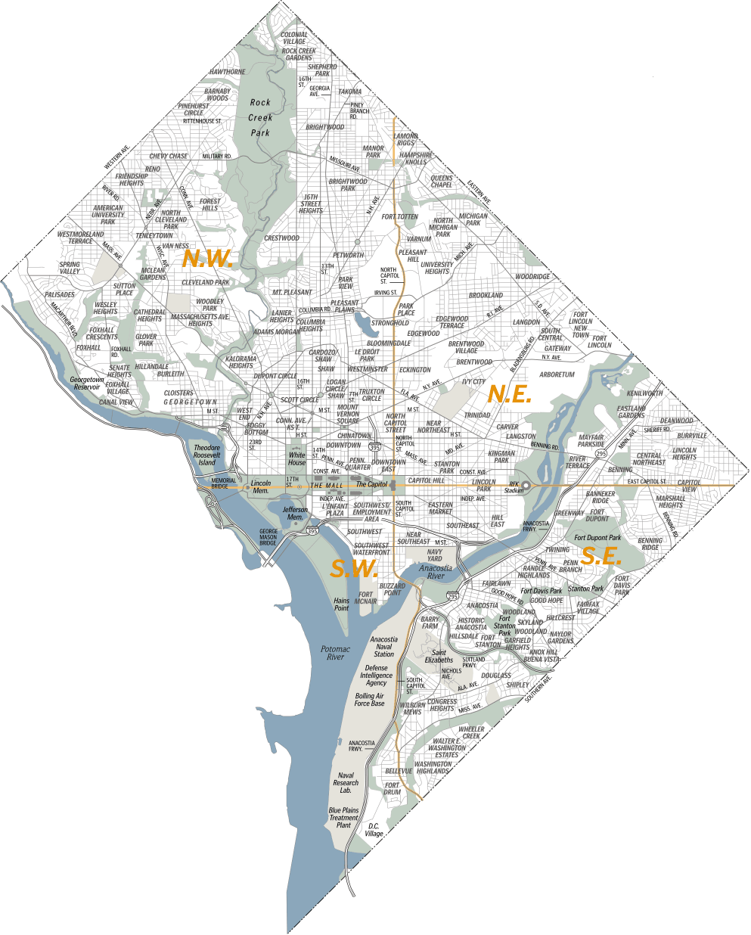
Objective
Analyze 10 years of DC crime data, detect patterns, and answer below
What method & type of Crime across years in DC area
During which time of the day crime happens
Which district &quad has the highest level of Crime & what type of Crime
Which weapon is more used Gun or Knife
Homicides using Gun across DC
As in many major cities, crime remains a significant factor in D.C. with ~70% more homicides compared to the national data.
The District ranked (killing rate) as the 16th most dangerous out of the nation's 50 biggest big cities in the country

Slide 3
Steps in Analysis
Data Collection
Tools & Libraries
Python
pandas
numpy
matplotlib.pyplot
seaborn
Mapsplotlib
time
Mplleaflet
Jupyter notebook
Excel (csv)
mapsplotlib API (Google maps background)
GitHub
Data Cleanup
Classification
Patterns
Visualization

Slide 4
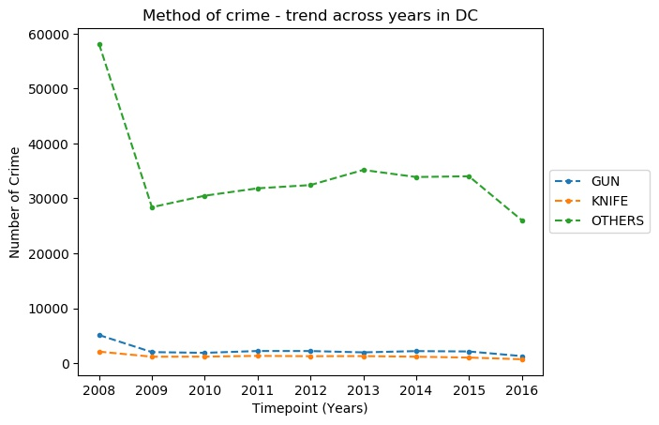
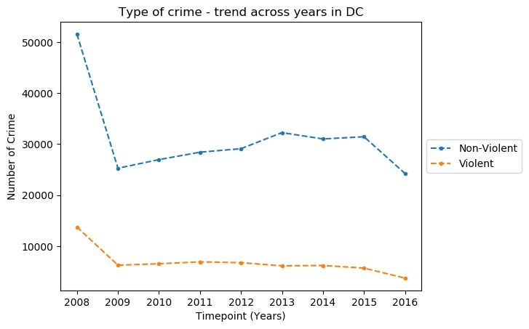
Crime pattern – Type & Method
Relatively less violent crime
Very high crime rate before year 2009
Number of crimes stayed almost same for 7 years
Reducing trend of over all and violent crime starting year 2016

Slide 5
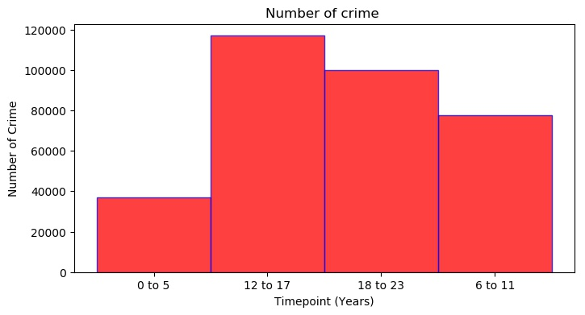
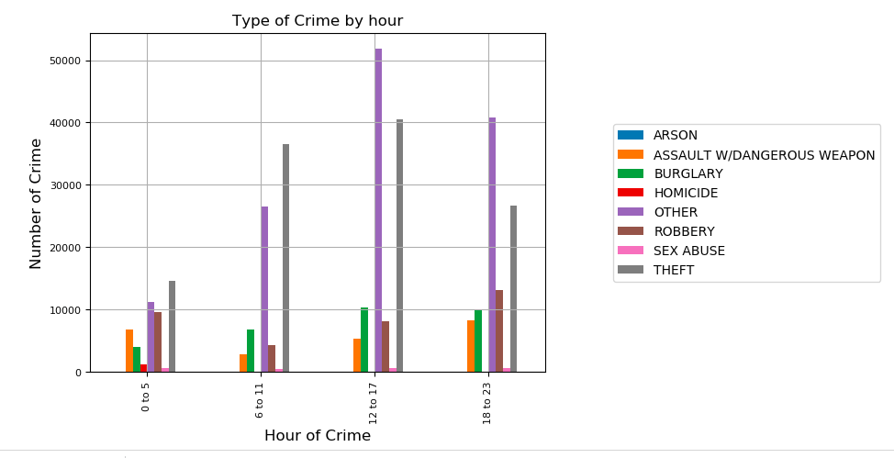
Crime pattern – Time of crime
High crime rate is observed during afternoon time, but they are mostly non-violent
Theft is common and most happening crime throughout the day
Violent crimes like Homicide happens past midnight but relatively insignificant during other time of the day
Relatively minimal sexual abuse

Slide 6
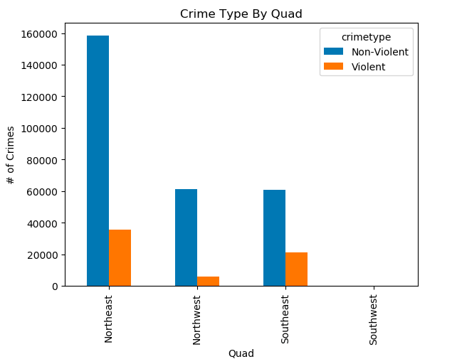
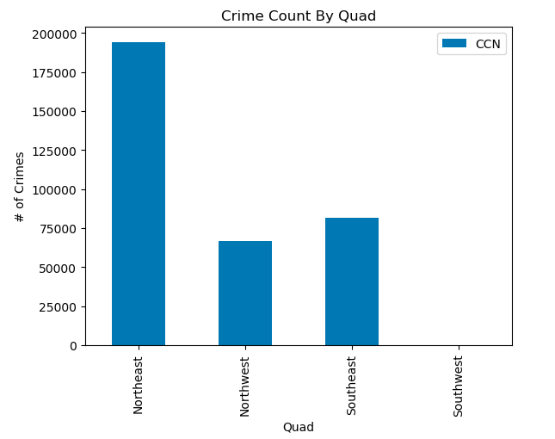
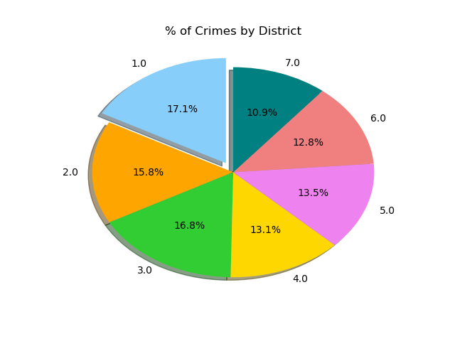
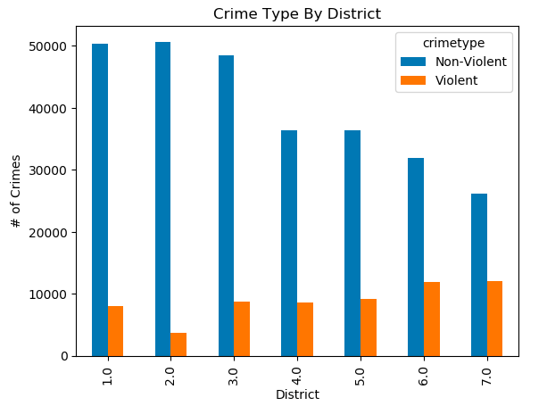
Patterns across districts & quads
District 6 & 7 have lesser number of crimes, but most of them is Violent crimes
Northeast part of DC is the high crime and unsafe Quad
SouthWest has very minimal crimes and the most safe area in entire DC
NorthWest, though has significant number of crime, it is mostly non violent

Slide 7
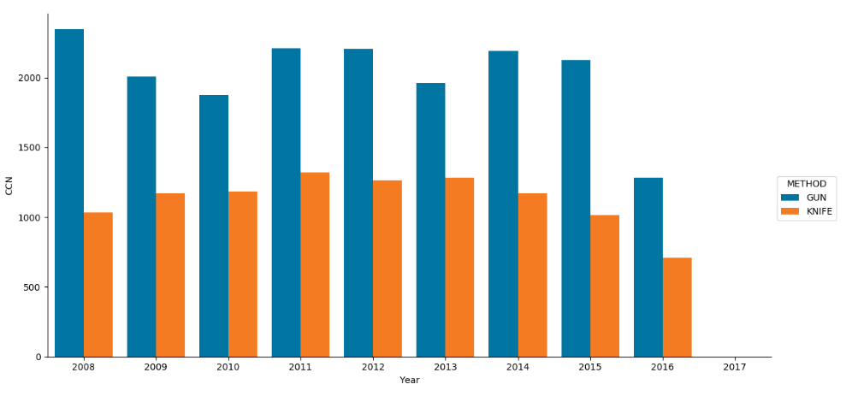
Gun Vs Knife
On an average, across years, Gun is the most used weapon in all crimes

Slide 8
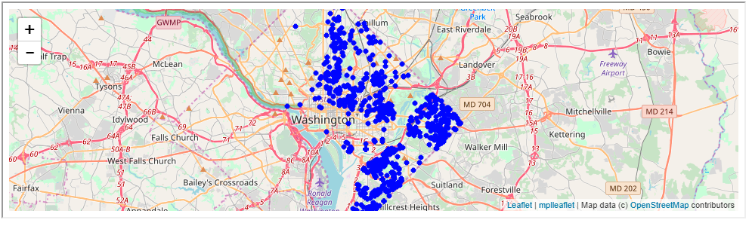
Gun Homicide
Northeast Quad has the most crimes (homicides) with Gun
Very few crime in Southwest Quad
Even in high crime Quads, crime happens mostly on specific areas

Slide 9
Summary & Conclusion:
High rate of theft/burglary/robbery
Northeast is the most unsafe Quad in DC
Southwest is the most safe Quad in DC
High usage of Gun then knife or any other weapon
Overall crime is reducing significantly in the past 10 years

